Slide 1

Higher Derivatives
RCET 0264 Introductory Calculus
Tim Leishman

Slide 2

Higher Derivatives
Find the first four derivatives of each function.
Function 1. $y=x^{5}+{3x}^{2}$
$y^{′}=$ 5$x^{4}+6x$
$y^{′′}=$ $20x^{3}+6$
$y^{′′′}=$ 60$x^{2}$
$y^{′′′′}=120x$

Slide 3
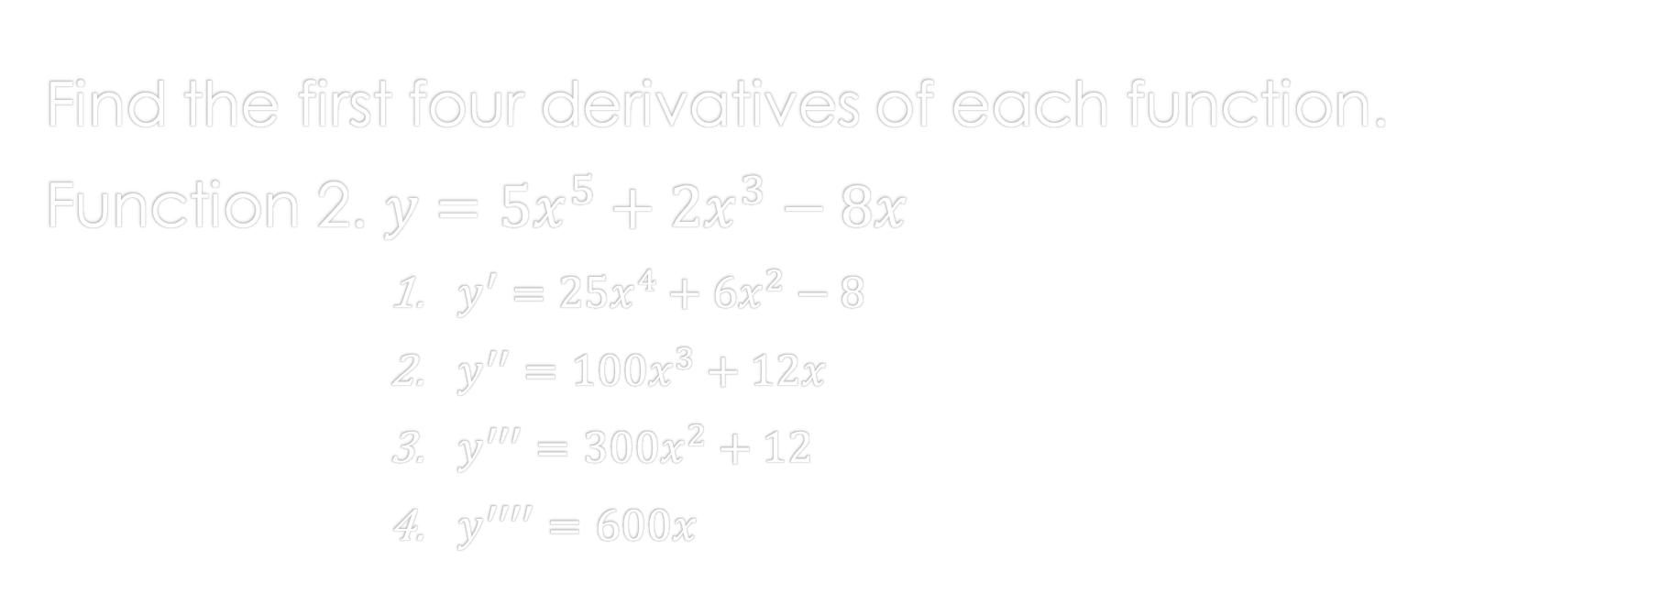
Higher Derivatives
Find the first four derivatives of each function.
Function 2. $y={5x}^{5}+{2x}^{3}−8x$
$y^{′}=25x^{4}+6x^{2}−8$
$y^{′′}=$ $100x^{3}+12x$
$y^{′′′}=$ $300x^{2}+12$
$y^{′′′′}=$ $600x$

Slide 4

Higher Derivatives
Acceleration:
$velocity \left(v\right)=\frac{ds}{dt}$
$acceleration \left(a\right)= \frac{dv}{dt}$
$acceleration \left(a\right)=\frac{dv}{dt}=\frac{d^{2}s}{dt^{2}}$

Slide 5
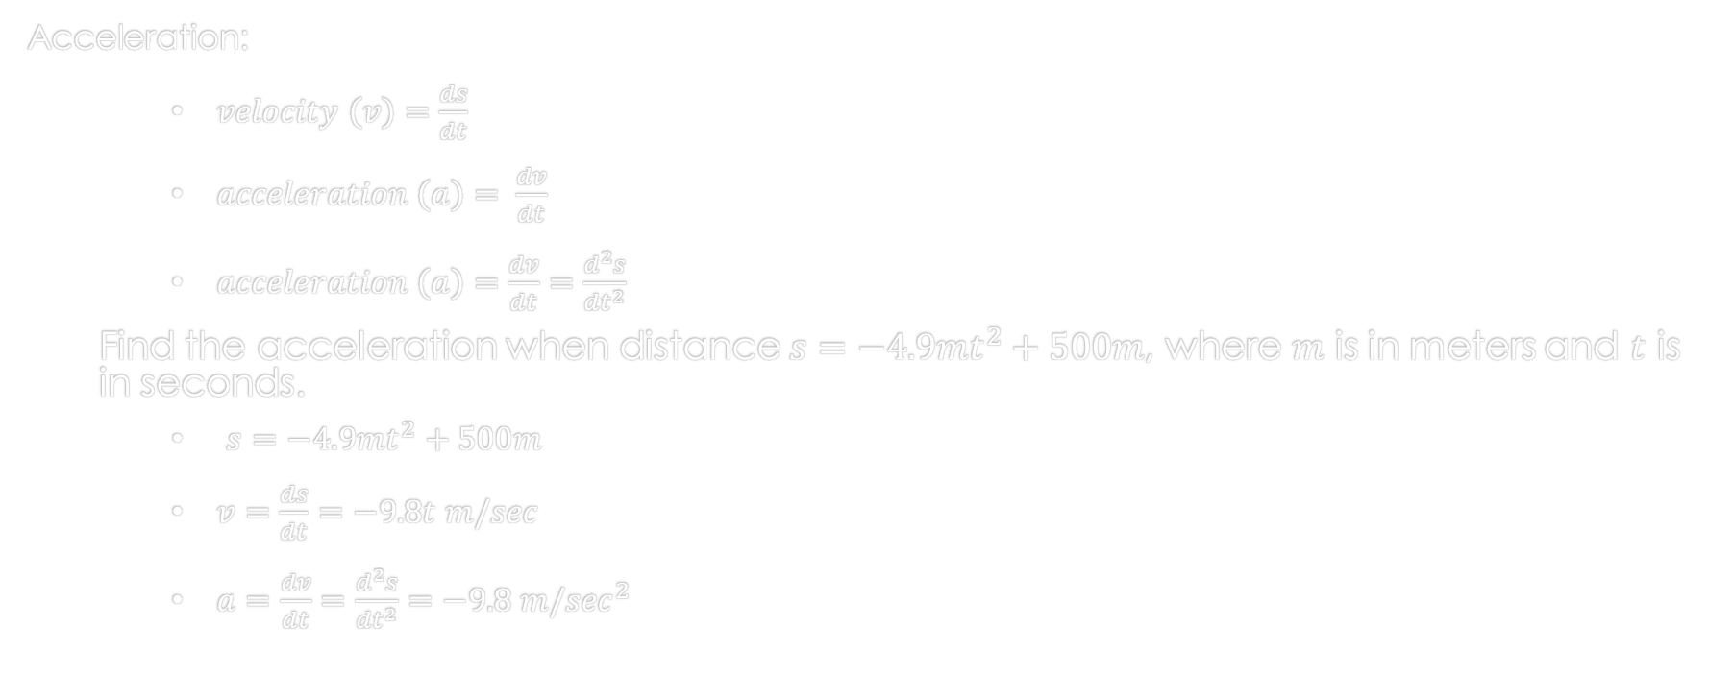
Higher Derivatives
Acceleration:
$velocity \left(v\right)=\frac{ds}{dt}$
$acceleration \left(a\right)= \frac{dv}{dt}$
$acceleration \left(a\right)=\frac{dv}{dt}=\frac{d^{2}s}{dt^{2}}$
Find the acceleration when distance $s=−4.9mt^{2}+500m$, where $m$ is in meters and $t$ is in seconds.
$s=−4.9mt^{2}+500m$
$v=\frac{ds}{dt}=−9.8t m/sec$
$a=\frac{dv}{dt}=\frac{d^{2}s}{dt^{2}}=−9.8 m/\sec^{2}$

Slide 6
References:
Ewen, D., Gary, J. S., & Trefzger, J. E. (2005). Technical calculus. Upper Saddle River, NJ: Pearson/Prentice Hall.
https://www.desmos.com
https://www.autodesk.com/products/fusion-360/overview

